Slide 1

Pager Rotation in DevOps
Marissa Lee
CSD380
Module 7- Assignment 7.2

Slide 2

What is “pager rotation”?
Pager Rotation is another phrase for On Call Rotation
Homage to the days of utilizing pagers for on-call administrative duties (AlertOps)
On Call Rotation is used for incident response
Customer Service
Outages
Cyber attacks or Security Breaches
Anything that requires quick workaround time (AlertOps)

Slide 3
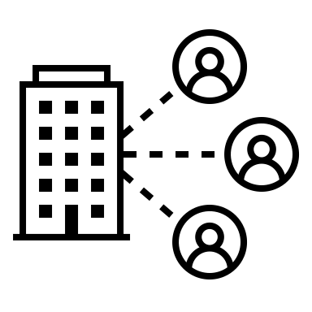
Benefits to pager rotation
Always someone available to handle incidents
Prevent any system downtime
If executed properly:
Even workload for employees
Better work-life balance (Increment)

Slide 4

Things to consider
Company size
How to split up on-call shifts
Employee workplace composition
Different approaches available depending on whether employees are spread throughout different timezones (SquadCast)
“Follow the Sun” Approach
Workload
Should still be able to support personal time off and holidays(SquadCast)
Rotation Types
Handoff Procedures
Keep communication organized

Slide 5

Scheduling
Multiple Time-Zones:
Follow-the-Sun approach: for teams with enough members in enough different time zones (SquadCast)
Members can work during regular work hours, once over the next time zone will pick up the shift
Single-Region Team
Shift rotation: Split into 3-4 groups, each group takes turns working night shift for weeks or months at a time. Prevents exhaustion (SquadCast)
If working with a smaller team, the schedule could rotate biweekly. (Incident)

Slide 6

training
Not everyone will be able to handle every conflict alone (Incident)
Shadow shifts help prepare members for a wide range of conflicts
Shadow-shifts can help prepare team members for independent on-call shifts
Promotes supportive work environment (Incident)
Prevents task overload on more experienced workers

Slide 7

Organization + communication
Good practice to implement handoff procedures for the next shift (SquadCast)
Shift will hand off a summary of incidents, ongoing and closed, to the next shift
Helps prevent confusion and encourages organization

Slide 8
Sources
"Crafting Sustainable On-Call Rotations." Increment, https://increment.com/on-call/crafting-sustainable-on-call-rotations/. Accessed 22 Sep 2024.
"On-Call Rotation." AlertOps, https://alertops.com/on-call-rotation/. Accessed 22 Sep 2024.
"On-Call Rotation." Squadcast, https://www.squadcast.com/sre-best-practices/on-call-rotation. Accessed 22 Sep 2024.
"On-Call Rotation Best Practices." Incident.io, https://incident.io/hubs/on-call/on-call-rotation-best-practices. Accessed 22 Sep 2024.

